Slide 1


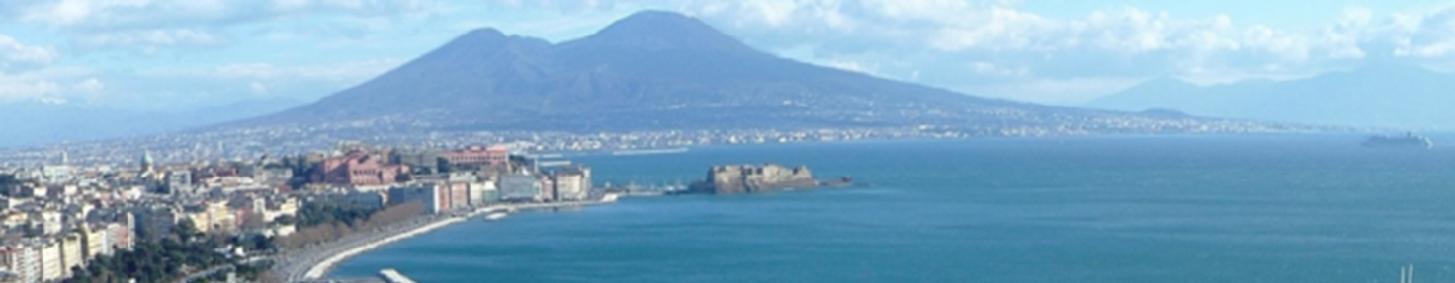
4th annual COCIR Digital Health Summit:
The voice of the stakeholders
Panel Debate 1: Scaling Up Digital Health
Campania experience in the framework of the
EIP on AHA
Maddalena Illario, MD, PhD
Campania Health Directorate Division on Health Innovation
RSCN co-Chair
A3 EIP on AHA Action Group co-coordinator

Slide 2


International cooperation supporting Public Health:
The example of the European Innovation Partnership on Active and Healthy Ageing
Gov/Health/Care
TWO STREAMS FOR ACTION
Action
Groups
Reference Sites
Academic
Industry
Civil Society
Current challenges: High levels of health inequalities in many EU countries
New standards for hospital beds
Financial/economic balance of the regional health systems
rationalization and qualification of spending
Increase the clinical and organizational appropriateness of LEA delivery
Standardization of Integrated Pathways
Explain and encode the extension of care and cure response on technological innovations to citizens
Translate part of strategic planning into goals that can be pursued with innovative methodologies
Taking advantage of the opportunities offered by the EU Commission through international cooperation
Notes:
A stakeholder-led, cross sectorial, collaboration initiative for research, innovation & intervention.
Launched 2012 as part of Europe 2020 Strategy.
Reach a critical mass for action by pooling EU resources/ expertise & recognising innovation/ excellence.
74 Regional and local organisations
Strategies to advance innovation for active and healthy ageing
Investing over €4 billion (2016-2019 period)
Benefiting five million people over 3 years
Goals
Improve Quality of Life
Enhance Sustainability of Healthcare systems
Stimulate Economic growth and competitiveness

Slide 3
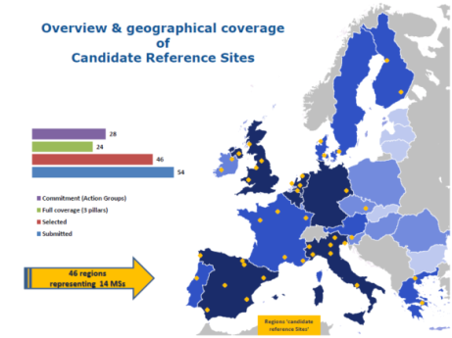
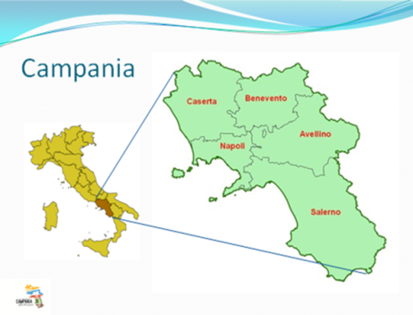
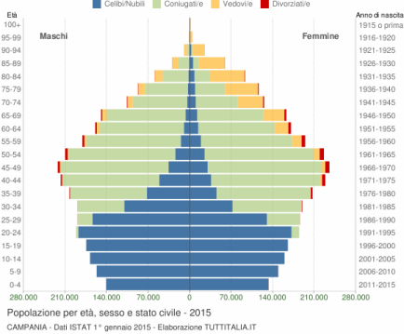
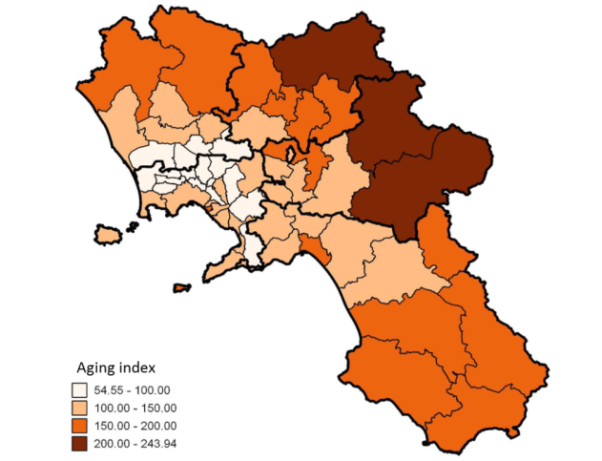
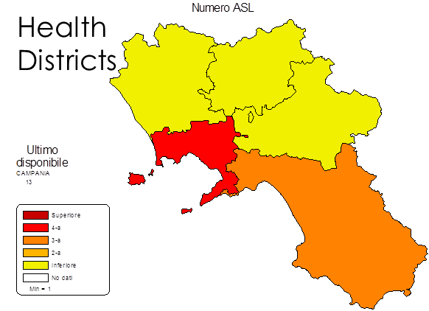
5,869 milion residents
Third most populated region
The most crowded: 432 inhab/km²
Ageing index: 117 (2016, was 77.2 in 2002)
Mortality rate National Average: 10
Mortality rate in Campania Region: 8.9 (2016, was 8.2 in 2002)
Older adults dependency index: 26.7 (2016, from 21.2 in 2002)
Older adults (>65): 17.9 (2016, from 12.3 in 2002)
Life expectancy Campania Region / National Average (F, 2016): 83.5 / 85.1
Life expectancy Campania Region / National Average (M, 2016): 78.9 / 80.6
Residents
Health Districts
Hospital beds
GPs

Slide 4



EIP-AHA CAMPANIA RS
THREE-FOLD LEVELS STRATEGY
ACROSS EUROPEAN, NATIONAL AND REGIONAL LEVELS
IDENTIFICATION OF WORKING GROUPS
VALORIZATION OF ONGOING LOCAL INITIATIVES
NETWORKING
COORDINATION
LIASING WITH DISTRICTS/CENTERS OF EXPERTISE
RSCN
OTHER NETWORKS
EC
HEALTH MINISTRY
MATTONE INTERNAZIONALE
ICT-INTEROPERABILITY
SOCIAL-HEALTH INTEGRATION
INTERNATIONAL
APPROACH
PRIORITY ISSUES
HEALTH & ICT LITERACY
MULTI-DIMENSIONAL &
LIFECOURSE APPROACH TO AGEING
Digital innovation can help unlock the potential of technology to address societal needs:
From SMART CITIES to SMART CITIZENS
to address local challenges by shared solutions

